Slide 1
Error Control

Slide 2
Error Control
Positive and Negative feedback
Timers : what happens when a frame completely vanishes : receiver neither sends a +ack nor –ack … then timer comes to help.
It may result in a frame being sent more than once and received more than once
solution : assign sequence numbers to frames

Slide 3
Error Detection and Correction
Networks must be able to transfer data from one device to another with complete accuracy.
Data can be corrupted during transmission.
For reliable communication, errors must be detected and corrected.
Error detection and correction are implemented either at the data link layer or the transport layer of the OSI model.

Slide 4
Error Detection and Correction
In some cases it is sufficient to detect an error and in some, it requires the errors to be corrected also. For eg.
On a reliable medium : ED is sufficient where the error rate is low and asking for retransmission after ED would work efficiently
In contrast, on an unreliable medium : Retransmission after ED may result in another error and still another and so on. Hence EC is desirable.

Slide 5
Network designers have developed two basic strategies for dealing with errors. Both add redundant information to the data that is sent.
One strategy is to include enough redundant information to enable the receiver to deduce what the transmitted data must have been.
The other is to include only enough redundancy to allow the receiver to deduce that an error has occurred (but not which error) and have it request a retransmission.
The former strategy uses error-correcting codes and the latter uses error-detecting codes.
Use of error-correcting codes is called as Forward Error Correction

Slide 6
Types of Errors

Slide 7
Single-bit error

Slide 8
Single bit errors are the least likely type of errors in serial data transmission because the noise must have a very short duration which is very rare. However this kind of errors can happen in parallel transmission.
Example:
If data is sent at 1Mbps then each bit lasts only 1/1,000,000 sec. or 1 μs.
For a single-bit error to occur, the noise must have a duration of only 1 μs, which is very rare.

Slide 9
Burst error

Slide 11
The term burst error means that two or more bits in the data unit have changed from 1 to 0 or from 0 to 1.
Burst errors does not necessarily mean that the errors occur in consecutive bits, the length of the burst is measured from the first corrupted bit to the last corrupted bit. Some bits in between may not have been corrupted.

Slide 12
Burst error is most likely to happen in serial transmission since the duration of noise is normally longer than the duration of a bit.
The number of bits affected depends on the data rate and duration of noise.
Example:
If data is sent at rate = 1Kbps then a noise of 1/100 sec can affect 10 bits.(1/100*1000)
If same data is sent at rate = 1Mbps then a noise of 1/100 sec can affect 10,000 bits.(1/100*10⁶)

Slide 13
Redundancy : is the central concept in detecting & correcting errors. We need to send some extra bits with our data.
These redundant bits are added by the sender and removed by the receiver .

Slide 14
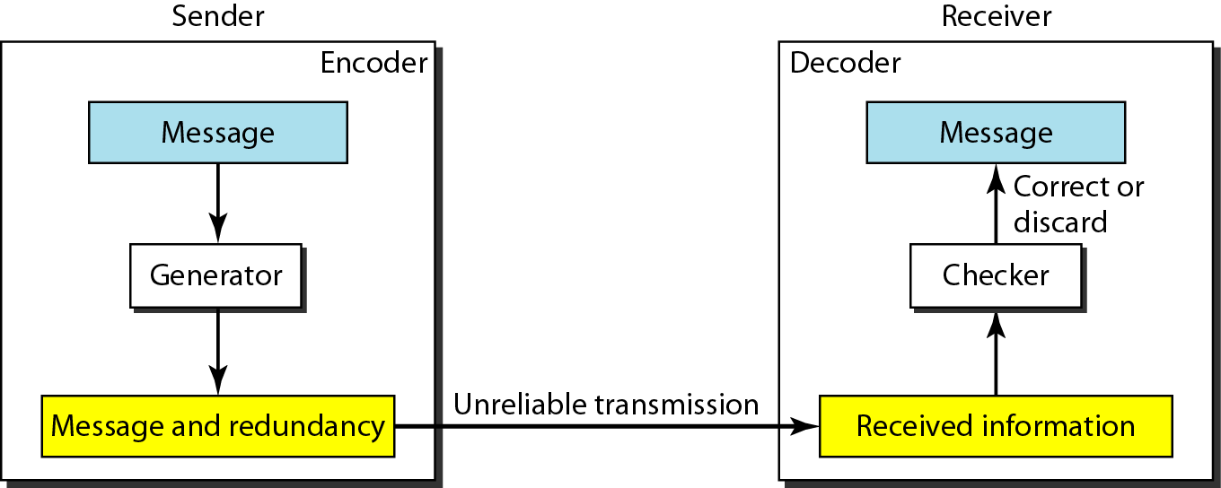
The structure of encoder and decoder

Slide 15
Detection Versus Correction
In error detection, we are looking only to see if any error has occurred. A single-bit error is the same for us as a burst error.
In error correction, we need to know the exact number of bits that are corrupted and more importantly, their location in the message. So the number of errors and the size of the message are important factors.
correction of errors is more difficult than the detection

Slide 16
Forward Error Correction Versus Retransmission
Two main methods of error correction
Forward error correction FEC: is the process in which the receiver tries to guess the message by using redundant bits.
Retransmission: is a technique in which the receiver detects the occurrence of an error and asks the sender to resend the message.
FEC is used if the number of errors is small.

Slide 17
Coding
Redundancy is achieved through various coding schemes. The sender adds redundant bits through a process that creates a relationship between the redundant bits and the actual data bits.
The receiver checks the relationships between the two sets of bits to detect or correct the errors.
The ratio of redundant bits to the data bits and the robustness of the process are important factors in any coding scheme

Slide 18
Coding schemes
1-block coding .
2-convolution coding.

Slide 19
BLOCK CODING
In block coding, we divide our message into blocks, each of kbits, called data words.
We add redundant bits to each block to make the length n = k + r. The resulting n-bit blocks are called code words.
With k bits, we can create a combination of 2^{k} data words; with n bits, we can create a combination of 2^{n} codewords.
The block coding process is one-to-one; the same data word is always encoded as the same code word. This means that we have 2^{n}-2^{k} code words that are not used.

Slide 20
Data words and code words in block coding

Slide 21
Convolutional Encoding
In telecommunication, a convolutional code is a type of error-correcting code that generates parity symbols via the sliding application of a boolean polynomial function to a data stream. The sliding application represents the 'convolution' of the encoder over the data, which gives rise to the term 'convolutional coding'.
Don’t send message bits, send only parity bits
Use a sliding window to select which message bits may participate in the parity calculations

Slide 22
Convolution coding is more complex than block coding.
In convolutional codes, the message comprises of data streams of arbitrary length and a sequence of output bits are generated by the sliding application of Boolean functions to the data stream.
In block codes, the data comprises of a block of data of a definite length. However, in convolutional codes, the input data bits are not divided into block but are instead fed as streams of data bits, which convolve to output bits based upon the logic function of the encoder.
Also, unlike block codes, where the output codeword is dependent only on the present inputs, in convolutional codes, output stream depends not only the present input bits but also only previous input bits stored in memory.

Slide 23
Error Detection
How can errors be detected by using block coding? If the following two conditions are met, the receiver can detect a change in the original code word.
1. The receiver has (or can find) a list of valid code words.
2. The original code word has changed to an invalid one.
An error-detecting code can detect only the types of errors for which it is; designed, other types of errors may remain undetected.

Slide 24
Hamming Distance
One of the central concepts in coding for error control is the idea of the Hamming distance.
The Hamming distance can easily be found if we apply the XOR operation (Θ) on the two words and count the number of 1’s in the result. Note that the Hamming distance is a value greater than zero.
The Hamming distance between two words is the number of differences between corresponding bits.

Slide 25
The Hamming distance d(000, 011) is 2 because
The Hamming distance d(10101, 11110) is 3 because

Slide 26
Minimum Hamming Distance - the measurement that is used for designing a code is the minimum Hamming distance.
To find this value, we find the Hamming distances between all words and select the smallest one.
The minimum Hamming distance is the smallest Hamming distance between all possible pairs in a set of words.

Slide 27
The dmin in this case is 2.

Slide 28
The dmin in this case is 3.

Slide 29
Three Parameters
Any coding scheme needs to have at least three parameters: the code word size n, the data word size k, and the minimum Hamming distance dmin.
A coding scheme C is written as C(n, k) with a separate expression for dmin.
For example, we can call our first coding scheme C(3, 2)
with dmin=2 and our second coding scheme C(5, 2) with dmin= 3.

Slide 30
Hamming Distance and Error
Relationship between the Hamming distance and errors occurring during transmission.
When a code word is corrupted during transmission, the Hamming distance between the sent and received code words is the number of bits affected by the error.
In other words, the Hamming distance between the received code word and the sent code word is the number of bits that are corrupted during transmission.
For example, if the code word 00000 is sent and 01101 is received, 3 bits are in error and the Hamming distance between the two is d(00000, 01101) =3.
To guarantee the detection of up to s errors in all cases, the minimum Hamming distance in a block code must be dmin= s + 1.

Slide 31
LINEAR BLOCK CODES
Almost all block codes used today belong to a subset called linear block codes. A linear block code is a code in which the exclusiveOR (additionmodulo-2) of two valid code words creates another valid code word.
In a linear block code, the exclusive OR (XOR) of any two valid code words creates another valid code word.

Slide 32
Minimum Distance for Linear Block Codes
It is simple to find the minimum Hamming distance for a linear block code.
The minimum Hamming distance is the number of 1s in the nonzero valid code word with the smallest number of 1s.

Slide 33
Error Detection
Error detection is the ability to detect the presence of errors caused by noise or other impairments during transmission from the transmitter to the receiver.
Error detection means to decide whether the received data is correct or not without having a copy of the original message.
Error detection uses the concept of redundancy, which means adding extra bits for detecting errors at the destination.

Slide 34
Three different error-detecting codes. They are all linear, systematic block codes:
1. Parity.
2. Checksums.
3. Cyclic Redundancy Checks (CRCs).

Slide 35
Parity
The stream of data is broken up into blocks of bits, and the number of 1 bits is counted. Then, a "parity bit" is set (or cleared) if the number of one bits is odd (or even).
The parity bit is chosen so that the number of 1 bits in the codeword is even (or odd).
Doing this is equivalent to computing the (even) parity bit as the modulo 2 sum or XOR of the data bits.
For example, when 1011010 is sent in even parity, a bit is added to the end to make it 10110100. With odd parity 1011010 becomes 10110101.

Slide 36
A code with a single parity bit has a distance of 2, since any single-bit error produces a codeword with the wrong parity. This means that it can detect single-bit errors.
If the tested blocks overlap, then the parity bits can be used to isolate the error, and even correct it if the error affects a single bit.

Slide 37
A single parity bit can only reliably detect a single-bit error in the block. If the block is badly garbled by a long burst error, the probability that the error will be detected is only 0.5, which is hardly acceptable.
Solution :
Interleaving - compute the parity bits over the data in a different order than the order in which the data bits are transmitted.
We compute a parity bit for each of the n columns and send all the data bits as k rows, sending the rows from top to bottom and the bits in each row from left to right in the usual manner. At the last row, we send the n parity bits.

Slide 38
Simple Parity-Check Code: the most familiar error-detecting code is the simple parity-check code.
In this code, a k-bit data word is changed to an n-bit code word where n = k + 1. The extra bit, called the parity bit, is selected to make the total number of 1s in the code word even.
A simple parity-check code is a single-bit error-detecting code in which n = k + 1 with dmin= 2.

Slide 39
Simple parity-check code C(5, 4)

Slide 40
Encoder and decoder for simple parity-check code

Slide 41
Some transmission scenarios. Assume the sender sends the data word 1011.
The code word created from this data word is 10111, which is sent to the receiver.
We examine five cases:
1.No error occurs; the received code word is 10111. The syndrome is 0. The data word 1011 is created.
2.One single-bit error changes a1. The received code word is 10011. The syndrome is 1. No data word is created.
3.One single-bit error changes r0. The received code word is 10110. The syndrome is 1. No data word is created.

Slide 42
4.An error changes r0 and a second error changes a3.
The received code word is 00110. The syndrome is 0.The data word 0011is created at the receiver. Note that here the data word is wrongly created due to the syndrome value.
5. Three bits—a3, a2, and a1—are changed by errors. The received code word is (01011). The syndrome is 1.The data word is not created.
This shows that the simple parity check, guaranteed to detect one single error ,can also find any odd number of errors.

Slide 43
Two-dimensional parity-check code

Slide 46
Checksum
The second kind of error-detecting code, the checksum, is closely related to groups of parity bits.
The word ‘‘checksum’’ is often used to mean a group of check bits associated with a message, regardless of how are calculated. A group of parity bits is one example of a checksum.
However, there are other, stronger checksums based on a running sum of the data bits of the message. The checksum is usually placed at the end of the message, as the complement of the sum function.
This way, errors may be detected by summing the entire received codeword, both data bits and checksum. If the result comes out to be zero, no error has been detected.

Slide 47
A checksum of a message is an arithmetic sum of message code words of a certain word length, for example byte values, and their carry value.
The sum is negated by means of ones-complement, and stored or transferred as an extra code word extending the message.
On the receiver side, a new checksum may be calculated from the extended message. If the new checksum is not 0, an error has been detected.

Slide 48
Checksum

Slide 50
The sender initializes the checksum to 0 and adds all dataitems and the checksum (the checksum is considered as one dataitem).The result is 36.
However, 36 cannot be expressed in 4bits.The extra two bits are wrapped and added with the sum to create the wrapped sum value 6.
The sum is then complemented, resulting in the checksum value 9(15−6=9).The sender now sends six dataitems to the receiver including the checksum 9.

Slide 51
The receiver follows the same procedure as the sender. It adds all dataitems (including the checksum); the result is 45.
The sum is wrapped and becomes 15. The wrapped sum is complemented and becomes 0.
Since the value of the checksum is 0, this means that the data is not corrupted. The receiver drops the checksum and keeps the other dataitems. If the checksum is not zero, the entire packet is dropped.

Slide 52
Sender site:
1.The message is divided into 16-bit words.
2.The value of the checksum word is set to 0.
3.All words including the checksum are added using one’s complement addition.
4.The sum is complemented and becomes the checksum.
5.The checksum is sent with the data.

Slide 53
Receiver site:
1.The message (including checksum) is divided into 16-bit words.
2.All words are added using one’s complement addition.
3.The sum is complemented and becomes the new checksum.
4.If the value of checksum is 0, the message is accepted; otherwise, it is rejected.

Slide 54
Cyclic redundancy check
The cyclic redundancy check considers a block of data as the coefficients to a polynomial and then divides by a fixed, predetermined polynomial. The coefficients of the result of the division is taken as the redundant data bits, the CRC.
On reception, one can recompute the CRC from the payload bits and compare this with the CRC that was received. A mismatch indicates that an error occurred.

Slide 55
Redundancy

Slide 56
Vertical Redundancy Check
VRC

Slide 57
It can detect single bit error
It can detect burst errors only if the total number of errors is odd.

Slide 58
Longitudinal Redundancy Check
LRC

Slide 59
LCR increases the likelihood of detecting burst errors.
If two bits in one data units are damaged and two bits in exactly the same positions in another data unit are also damaged, the LRC checker will not detect an error.

Slide 60
VRC and LRC

Slide 61
Error detecting code
Polynomial code or CRC( Cyclic Redundancy Check )
A message m : a string of bits corresponds to a polynomial denote it by M(x).
r check bits ….polynomial R(x).
Transmitted bits m + r ….polynomial
T(x) = M(x) + R(x)
Generator polynomial G(x)
r checkbits are computed so that when G(x) divides T(x), the remainder is zero.

Slide 62
At the receiving end, receiver again divides the polynomial corresponding to the received bits by G(x) and accepts it iff the remainder is zero.
Now let E(x) denote the polynomial corresponding to the errored bits. Then receiver receives
T’(x) = T(x) + E(x)
G(x) divides T’(x) iff it divides E(x)

Slide 63
Cyclic Redundancy Check
CRC

Slide 64
Cyclic Redundancy Check
Given a k-bit frame or message, the transmitter generates an n-bit sequence, known as a frame check sequence (FCS), so that the resulting frame, consisting of (k+n) bits, is exactly divisible by some predetermined number.
The receiver then divides the incoming frame by the same number and, if there is no remainder, assumes that there was no error.

Slide 65
Binary Division

Slide 66
Polynomial

Slide 67
Polynomial and Divisor

Slide 68
Standard Polynomials

Slide 69
Error Correction

Slide 70
Error Correction
It can be handled in two ways:
receiver can have the sender retransmit the entire data unit.
The receiver can use an error-correcting code, which automatically corrects certain errors.

Slide 71
Single-bit error correction
To correct an error, the receiver reverses the value of the altered bit. To do so, it must know which bit is in error.
Number of redundancy bits needed
Let data bits = m
Redundancy bits = r
∴Total message sent = m+r
The value of r must satisfy the following relation:
2^{r} ≥ m+r+1

Slide 72
Error Correction

Slide 73
Hamming Code
The number of data bits = 7
The number of redundant bits = 4
The total number of bits = 11
The redundant bits are placed at positions corresponding to power of 2- 1, 2, 4, and 8

Slide 74
Hamming Code
R1 bit is calculated using parity check at all the bits positions whose binary representation includes a 1 in the least significant position. R1: bits 1, 3, 5, 7, 9, 11
R2 bit is calculated using parity check at all the bits positions whose binary representation includes a 1 in the second position from the least significant bit. R2: bits 2,3,6,7,10,11

Slide 75
Hamming Code
R4 bit is calculated using parity check at all the bits positions whose binary representation includes a 1 in the third position from the least significant bit. R4: bits 4, 5, 6, 7
R8 bit is calculated using parity check at all the bits positions whose binary representation includes a 1 in the fourth position from the least significant bit. R8: bit 8,9,10,11

Slide 76
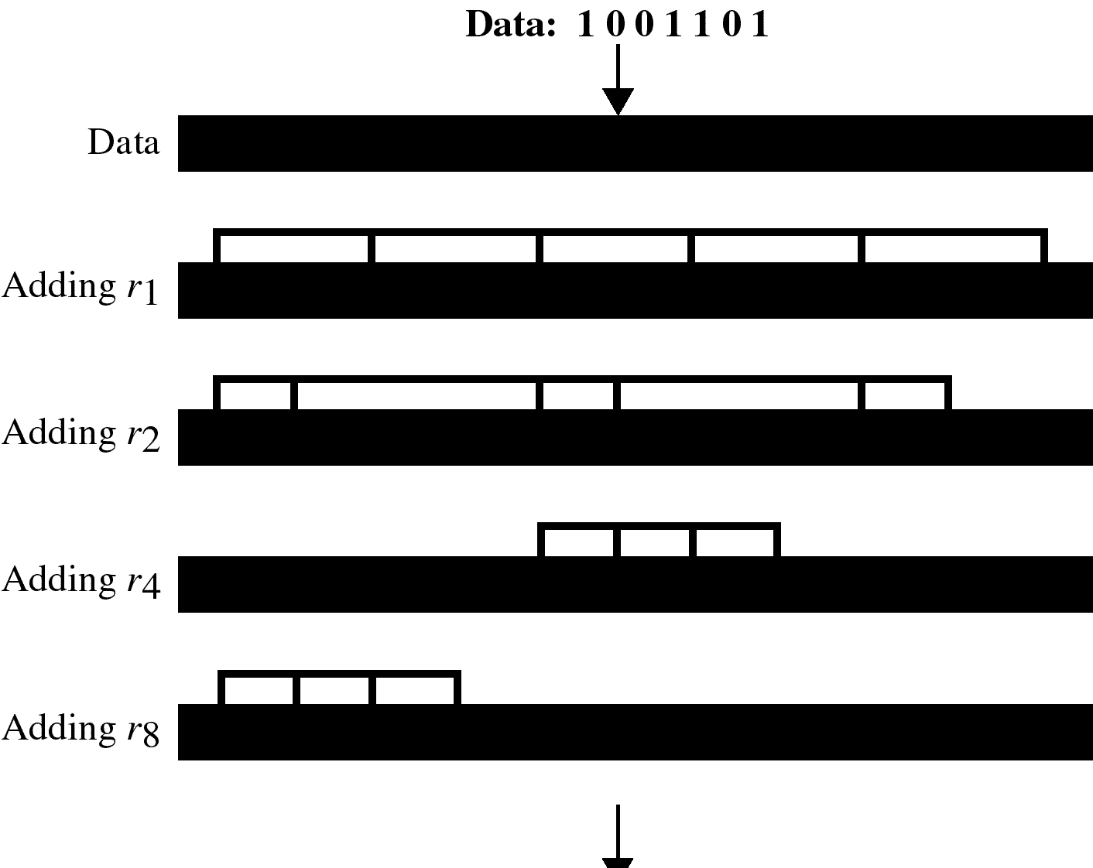
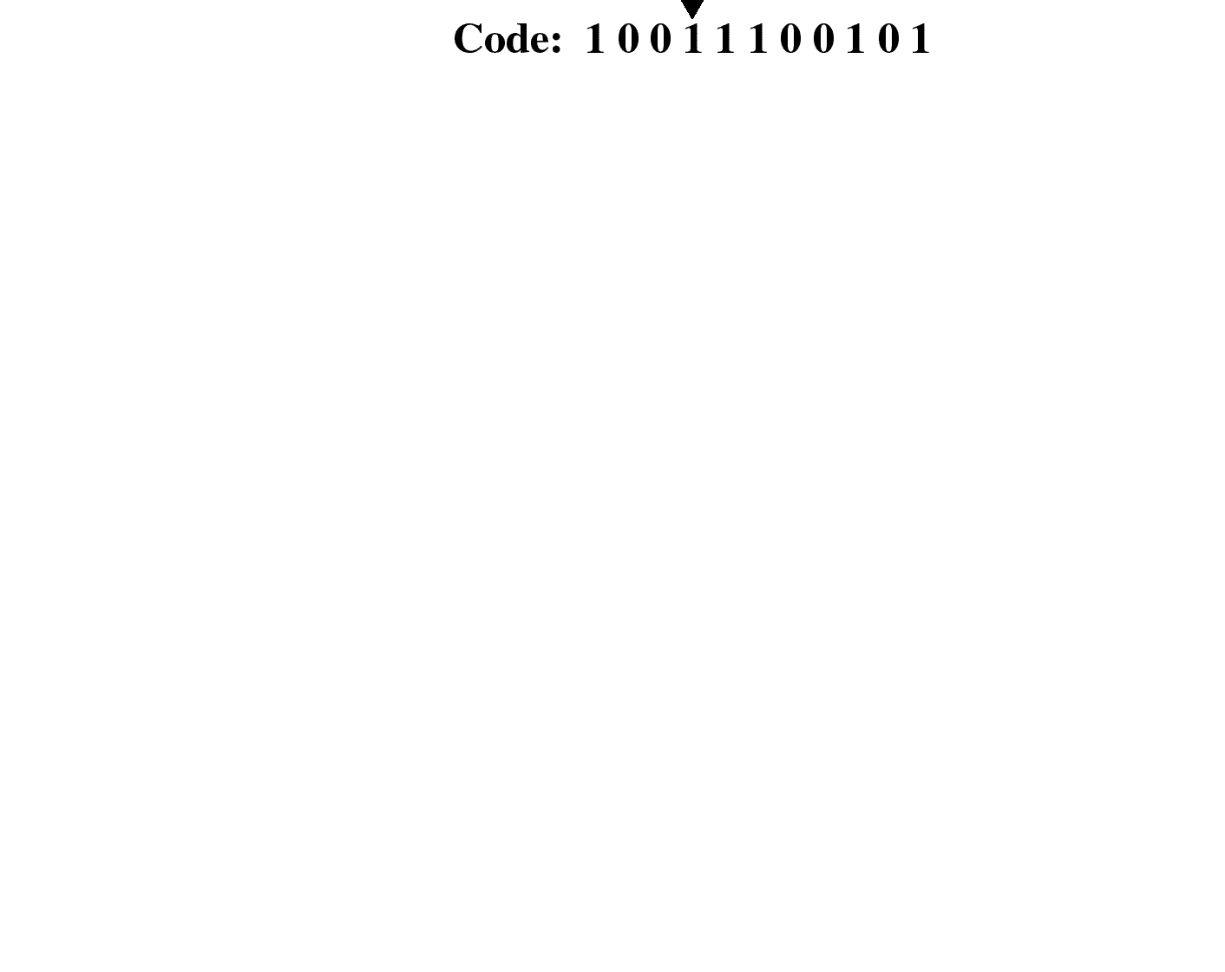
Example of Hamming Code
Redundant bit R1,
d3, d5, d7, d9, d11
R1 = d3 exor d5 exor d7 exor d9 exor d11
= 1 exor 0 exor 1 exor 0 exor 1
= 1
Redundant bit R2
d3, d6.d7, d10, d11
R2 = 1 exor 1 exor 1 exor 0 exor 1
= 0
Redundant bit R4
d5, d6, d7
R4= 0 exor 1 exor 1
= 0
Redundant bit R8
d9, d10, d11
R8 = 0 exor 0 exor 1
= 1

Slide 77
Single-bit error

Slide 78
Error
Detection

Slide 79
Hamming Codes : for ED and EC
m data bits together with r error check bits form and n = (m + r) bit codeword
The number of bits two codewords differ in is called the hamming distance between the two codewords
Significance : If two codewords are at HD d then it requires d single bit errors to convert one into the other

Slide 80
HD of a coding scheme
For m bit data .. All the 2^m possible combinations are legal
But not all the 2^n codewords are used
-- in a coding scheme (algorithm to compute the check bits) some of these codewords are legal and others are illegal
For eq .. Consider parity : 1(r = 1) parity bit is appended with value so that the total number of 1’s in the codeword is even ..
Then 11011 is a legal codeword in this scheme but 11010 is not

Slide 81
HD of a list of legal codewords
Minimum HD between any pair of legal codewords in the list
Each algorithm to compute the check bits create a different list of legal codewords

Slide 82
Use of HD for error detection
To detect d single bit errors , we need (an algorithm that creates) a code list with HD at least d + 1
For eg . For the parity scheme .. HD is 2 ..hence it can be used to detect single bit errors (d=1)

Slide 83
Continued…
If the received codeword is legal .. We accept it , and if it is illegal we report (detect) an error
Q1 : Can it happen that we receive a legal codeword when d single bit errors have occurred …this is equal to saying can we get a legal code from another legal code by d single bit errors?
A1 : No, since the HD of the code is at least d + 1. So a legal CW can be generated from another LCW by inverting at least d + 1 bits and not by inverting d or less bits.

Slide 84
Continued…
Q2 : Can we get an illegal CW when no error has occurred ?
A2 : Obviously not ..since the legal CW was sent by the sender and if no error has occurred then the receiver must receive a legal CW

Slide 85
Use of HD for error correction
To correct d single bit errors , we need (an algorithm that creates) a code list with HD at least 2d + 1.
For eg. Consider the following legal CWs:
0000000000, 0000011111,1111100000,1111111111
HD is 5 .. It can be used to correct 2 single bit errors

Slide 86
Continued..
Claim : Suppose we receive an illegal code C .. Then there is a unique legal code which is at a distance d or less from C
Proof : Suppose there are 2 codes C1 and C2 at distance d (or less) from C .. Then C1 can be obtained from C2 by 2d (or less) inversions .. A contradiction to (code has HD at least 2d + 1)

Slide 87
Continue…
Obtain C1 from C2
Lets rearrange the bits of C so that all the bits(B1) that are inverted to obtain C1 are in the beginning followed by bits(B2) inverted to obtain C2 ..followed by the remaining bits (B3) ..
In the worst case there is no overlapping between B1 and B2 ..
In that case C1 is obtained from C2 by inverting exactly these B1 and B2 bits which together are no more than 2d .. (if there is some overlapping then those bits are not inverted, hence < 2d)

Slide 88
Hamming Code to correct one bit errors
The bits of the CW are numbered left to right , starting from 1 … the bits that are powers of 2 are check bits (1,2,4,8 …) and the remaining are data bits.
Expand the position of each data bit in powers of 2 ..for eg. 11 = 1 + 2 + 8 .. So 11th bit contributes to the computation of value of these check bits I.e. 1,2, 8

Slide 89
Continued…
We do this for each data bit ..
The value of a check bit is computed so that the parity of the all the data bits that contribute to it together with the check bit itself is even.
For eg .
data bits 1001000 will be sent as the codeword 00110010000

Slide 90
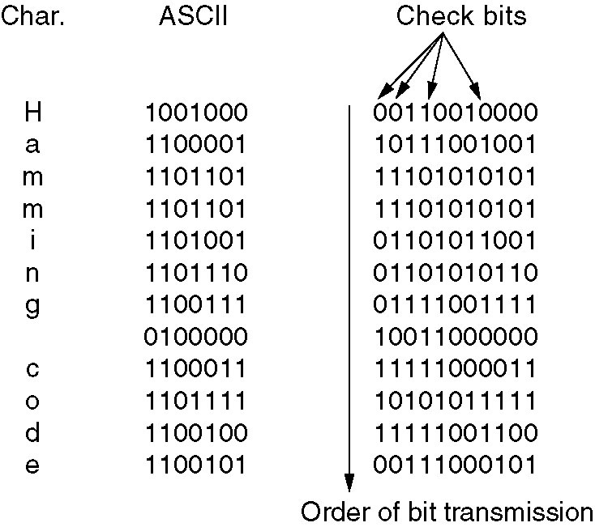
Hamming Code to correct burst errors

